Slide 1
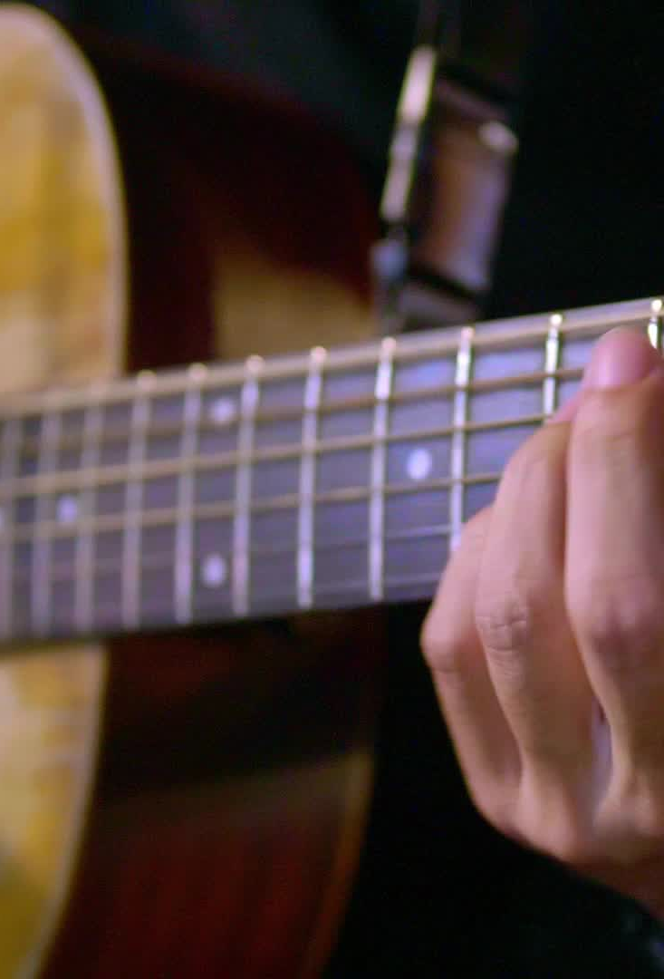
Desert Song
"Brooke Ligertwood
©2008 Hillsong Music Publishing Australia
CCLI Licence No. 5485849"

Slide 2
Verse 1
This is my prayer in the desert
When all that's within me feels dry
This is my prayer in my hunger and need
My God is the God who provides

Slide 3
Verse 2
And this is my prayer in the fire
In weakness or trial or pain
There is a faith proved of more worth than gold
So refine me Lord through the flame

Slide 4
Chorus
And I will bring praise, I will bring praise
No weapon formed against me shall remain
I will rejoice, I will declare
God is my victory and He is here

Slide 5
Verse 3
And this is my prayer in the battle
When triumph is still on its way
I am a conqueror and co-heir with Christ
So firm on His promise I'll stand

Slide 6
Chorus
And I will bring praise, I will bring praise
No weapon formed against me shall remain
I will rejoice, I will declare
God is my victory and He is here

Slide 7
Bridge
All of my life in every season
You are still God
I have a reason to sing
I have a reason to worship
(x3)

Slide 8
Chorus
And I will bring praise, I will bring praise
No weapon formed against me shall remain
I will rejoice, I will declare
God is my victory and He is here

Slide 9
Verse 4
And this is my prayer in the harvest
When favour and providence flow
I know I'm filled to be emptied again
The seed I've received I will sow

